Slide 1
Group Members
Shehryar Raza (BSCS-13020)
Abdul Jalil Mian (BSCS-13062)
Maria Kaleem (BSCS-13065)

Slide 2
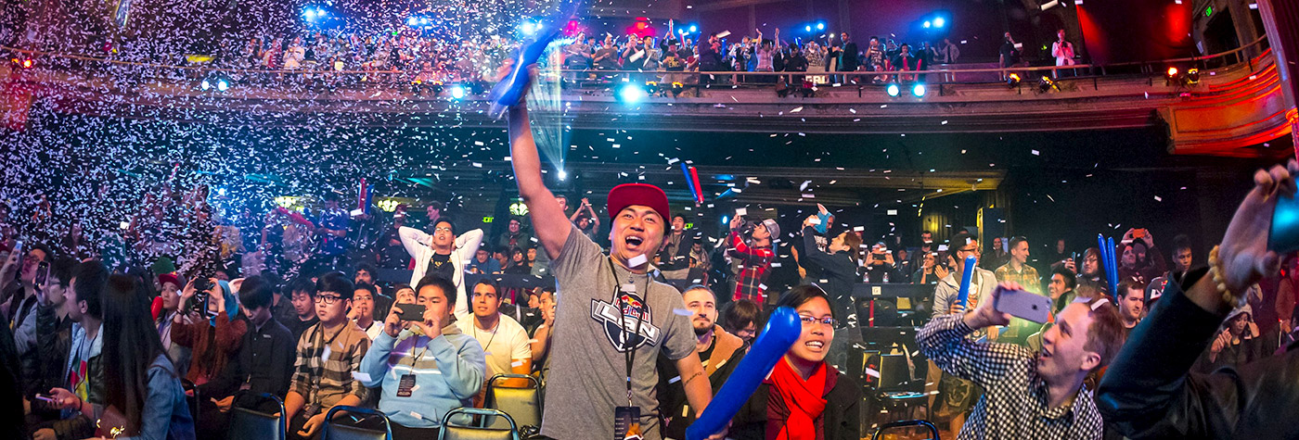
Esports Gaming in Pakistan

Slide 3
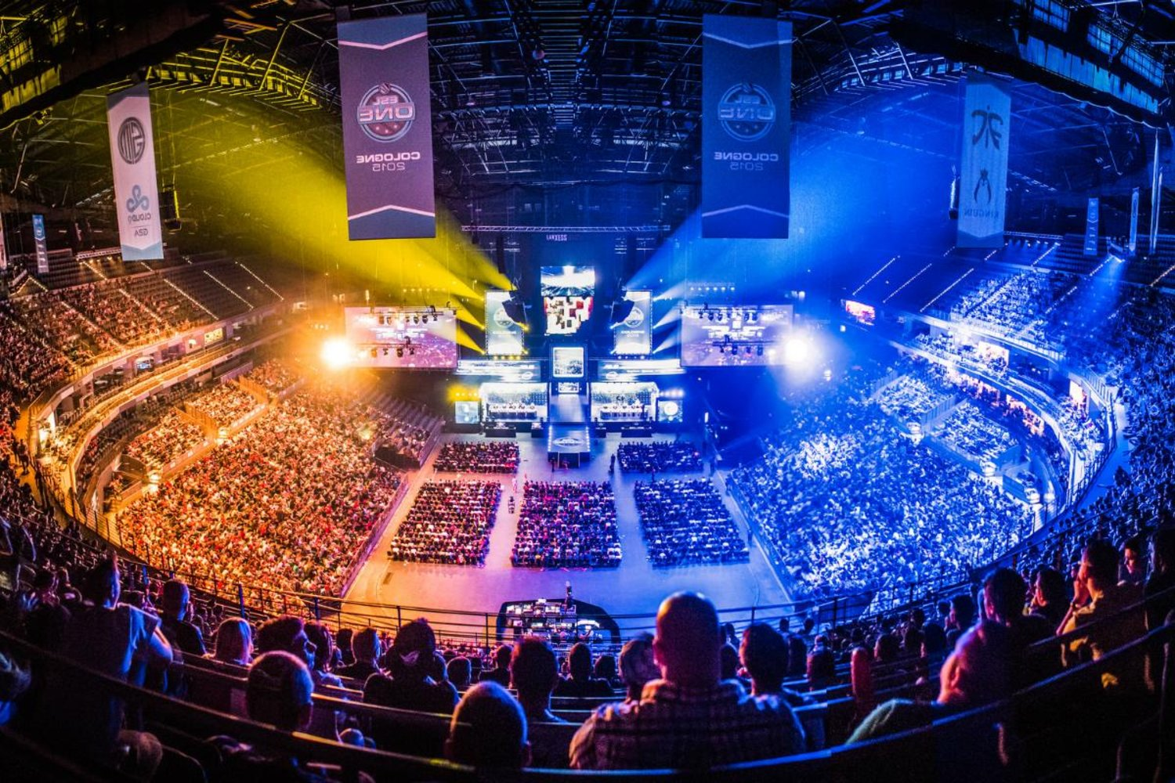
Introduction
Esports Gaming has been revolutionized
India and China are investing a lot of resources in esports
Pakistan is still struggling in the esports sector

Slide 4
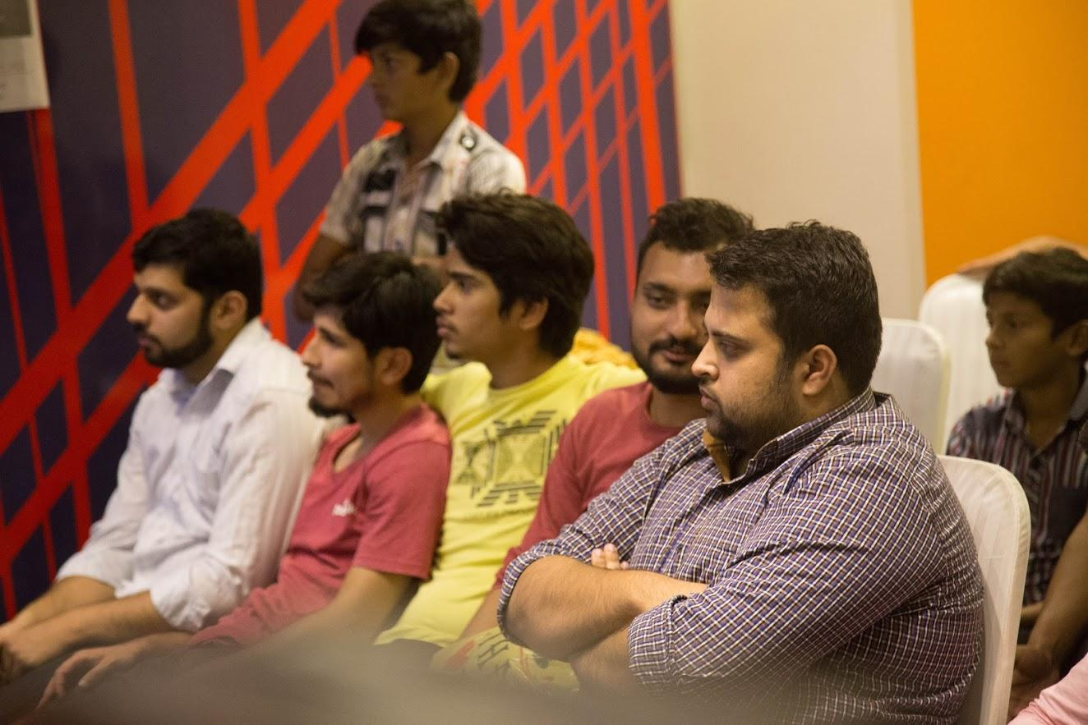
Needfinding Methodology (Who?)
Based on questionnaire, we conducted six interviews
The interviewees mostly belonged to a gaming community

Slide 5
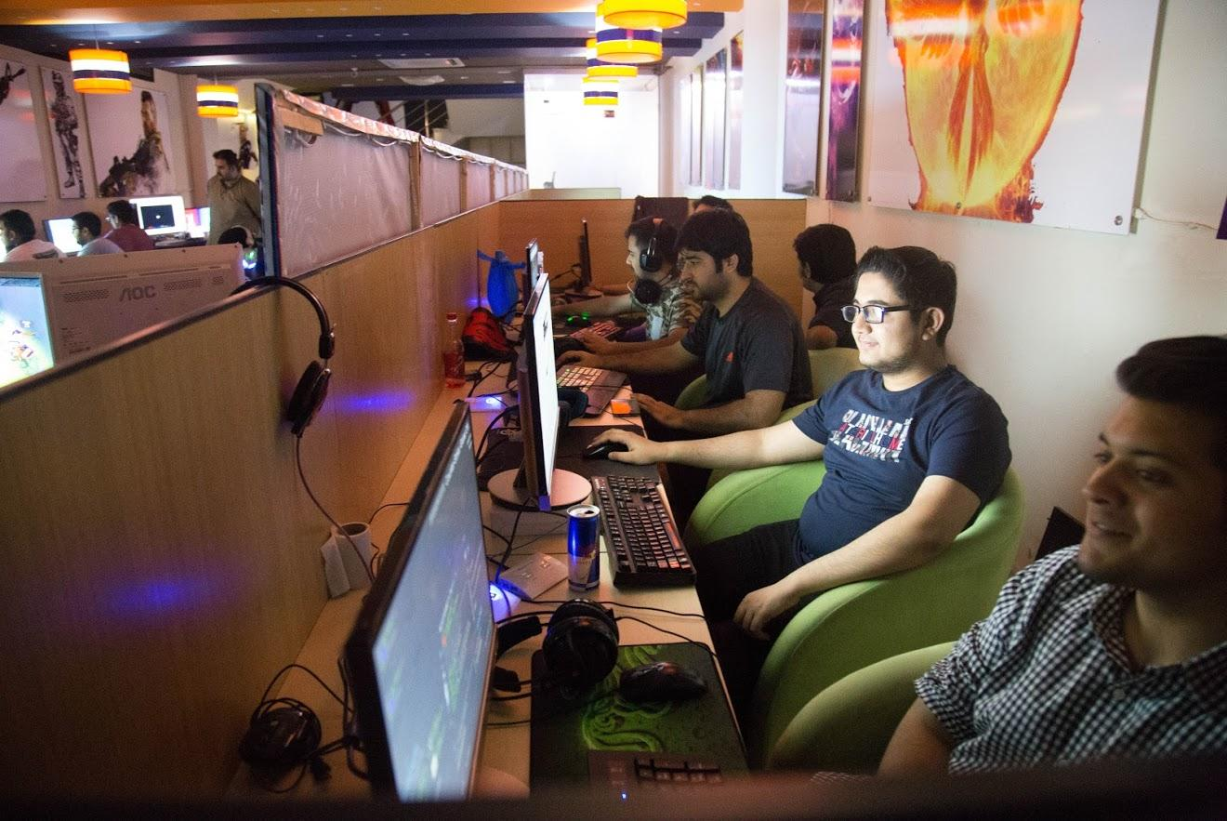
Needfinding Methodology (Why?)
We conducted the interviews from them because of two reasons
They are the extreme users and belong to a gaming community
Our focus area revolves around them

Slide 6
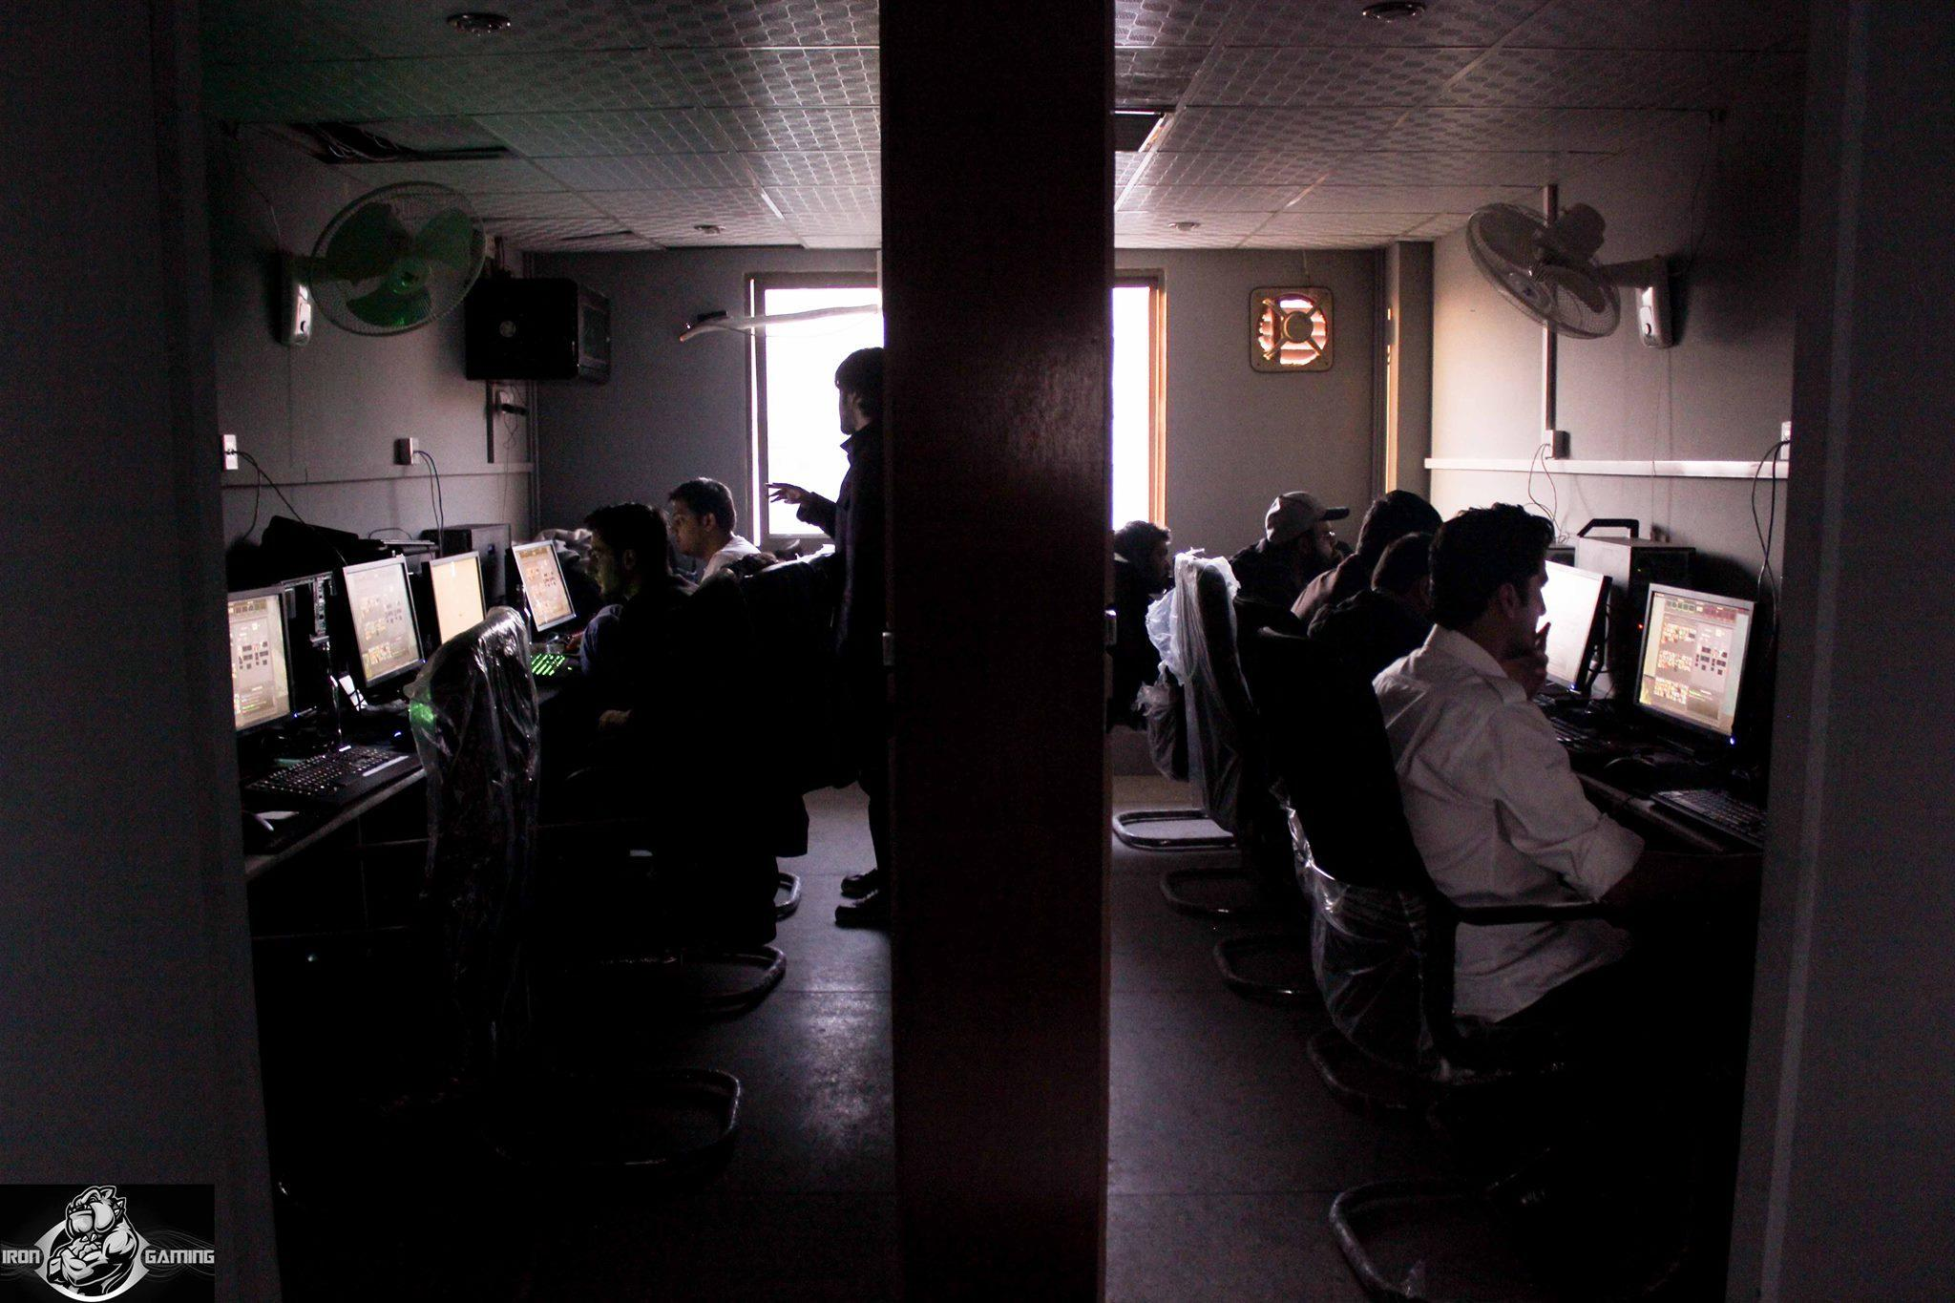
Needfinding Methodology (Where?)
We went to different gaming zones and commercial gaming companies to conduct the interviews

Slide 7
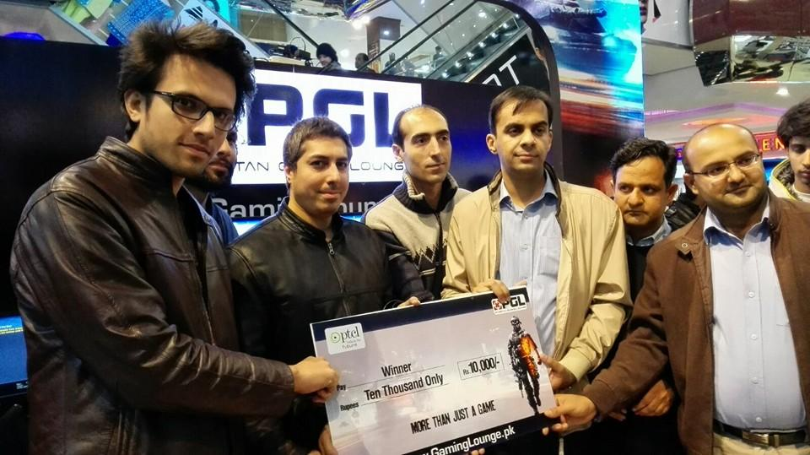
Interview results
Based on our questionnaire, the results were in the favor of an esports app
Most of the responses resembled this quote,
“it would be good to have an app that provides current info on your favourite game.”

Slide 8
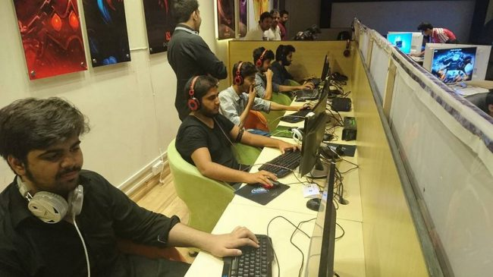
Interview results
50% of interviewees told that Pakistan needs to improve in the esports sector while the rest said that it is in the breakthrough process
The interviewees highly admired the need for the gaming community with the quotation,
“It would be very effective as you can play with the people from the same country you are in.”

Slide 9
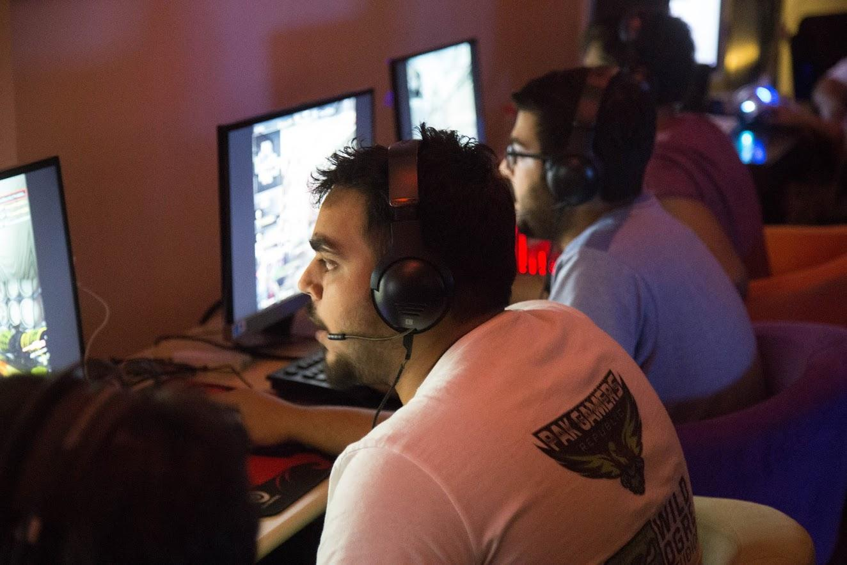
Interview results
90% of the interviewees rated an esports community app as 10/10 for Pakistan
When asked about the UI design, 90% of the interviewees told that it matters a lot

Slide 10
Analysis on Esports in Pakistan
Our questionnaire lead us to the following inferences/conclusions
Pakistan has a huge number of people that represents the gaming community
There are no big investments in the esports sector which causes us to lag behind our neighbour countries

Slide 11
Analysis on Esports in Pakistan
A platform/app is required to represent the esports community in Pakistan
There is no such app or website which notifies gamers about the gaming events in Pakistan
Empathy Map

Slide 12
Analysis on Esports in Pakistan
To overcome such problems, an app is required which will provide the latest news as well as the general community for the gamers in Pakistan
Needs

Slide 13
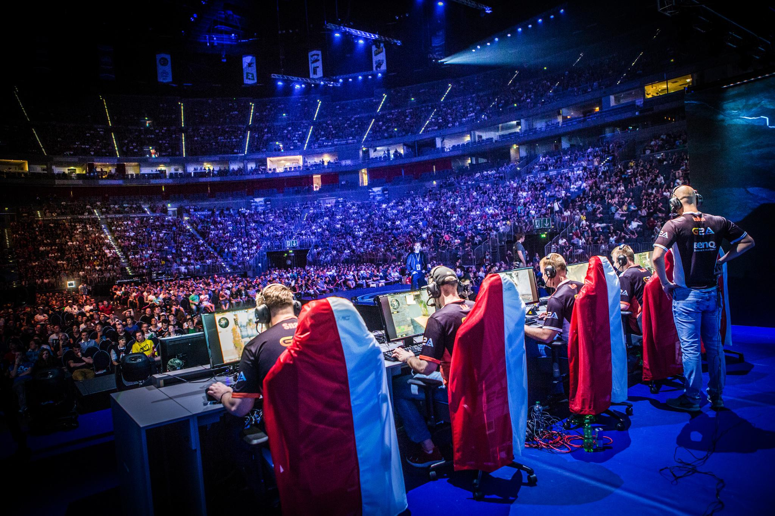
Summary
Esports Gaming in Pakistan needs special attention as the market has a bright future
The revenue generation in esports sector is huge and if companies start to invest in this sector, then eventually it will beneficial to the economy

Slide 14
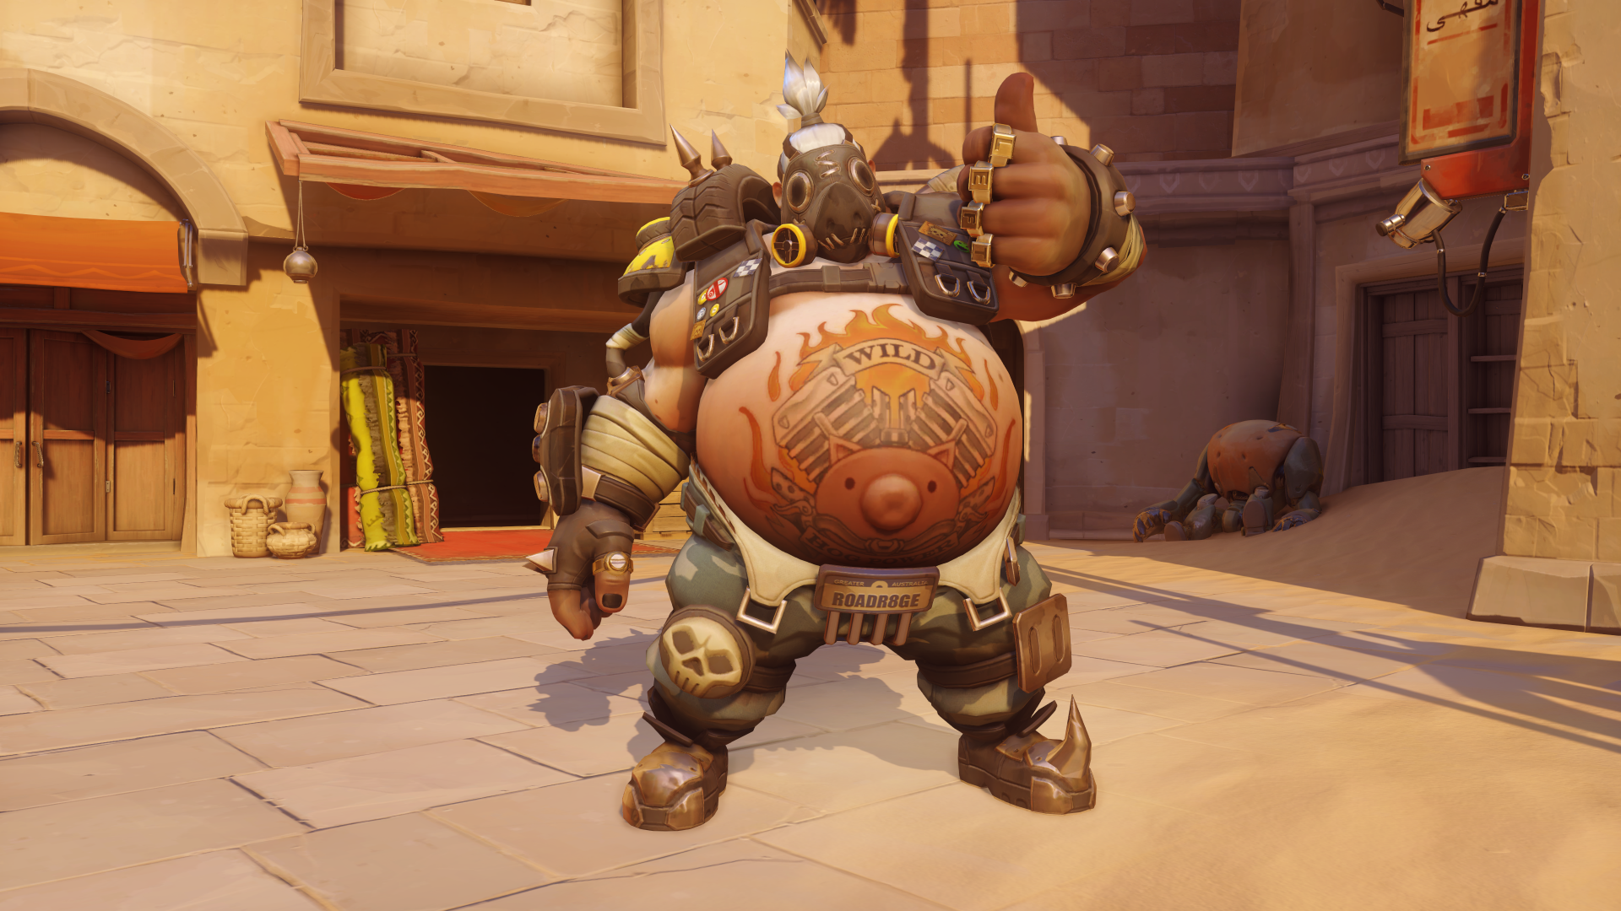

Thank You!

